Slide 1
Controlling Multiple Omnimagnet
Mohamed Ghori

Slide 2
Objective
Create a simulation in MATLAB that can give us an intuition on how multiple spherical magnets would behave in the magnetic field of an OMNIMAGNET, designed and created under the supervision of Professor Jake Abbott

Slide 3
Method of simulation
Using the kinematics of a ball rolling on a plane trajectories were designed for the spherical magnet- tool
These trajectories consist of positions and orientations that are defined and recorded by the simulation
Corresponding current values are found for each solenoid in the OMNIMAGNET according to the equations in the papers by Professor Jake Abbott
These current values are then played back in succession to a tool at an arbitrary initial orientation & position

Slide 4
Complete (MATLAB)
ROTATION
MAGNET
N
Spherical Magnet-Tool Kinematic Simulation
Ball on Plane kinematics
Singularities & Issues with Non-Injective functions in Sphere on Plane Kinematics Accounted
Sphere Point to Point Movment Function (Derived from Ball Kinematics)
Square Trajectory Function (Derived from Ball Kinematics)
Circle Trajectory Function (Derived from Ball Kinematics)
Magnetic Field Simulation
Magnetic-Field to Current & Current to Magnetic Field Functions (Professor Abbott’s Paper)
Current Change to Ball Movement Function(Ball Kinematics + Papers)
Playback Function to replay determined current values to a new tool
Presentation Tools
Visualization Function
Instructional Descriptions, Example Code & Citations
Results
A visual of the ball rolling in any arbitrary square or circle & Solenoid Current Data of the Omnimagnet

Slide 5
update
Learned & Installed GIT
Uploaded & Updated all Files on GIT
Sphere is now Transparent
Warnings Eliminated
Authorship and Citation Added
A Help Section has been Added to each Major Function (including an example)
Each CNTRL Function has a few Defaults (contingent to inputs)
Code Clean Up and Misc. Bugs Removed

Slide 6
In progress
Fixing code that converts from orientation to current
Issues include: SINGULARITIES
Adding visuals such as a unicolor mesh for the sphere and a bounding-sphere outline for the workspace

Slide 7
future
Fix Singularities resulting from current to orientation equations
Observe how the simulation reacts to different inputs
Record how the Playback reacts to different initial orientations and positions
Build Physical Model

Slide 8
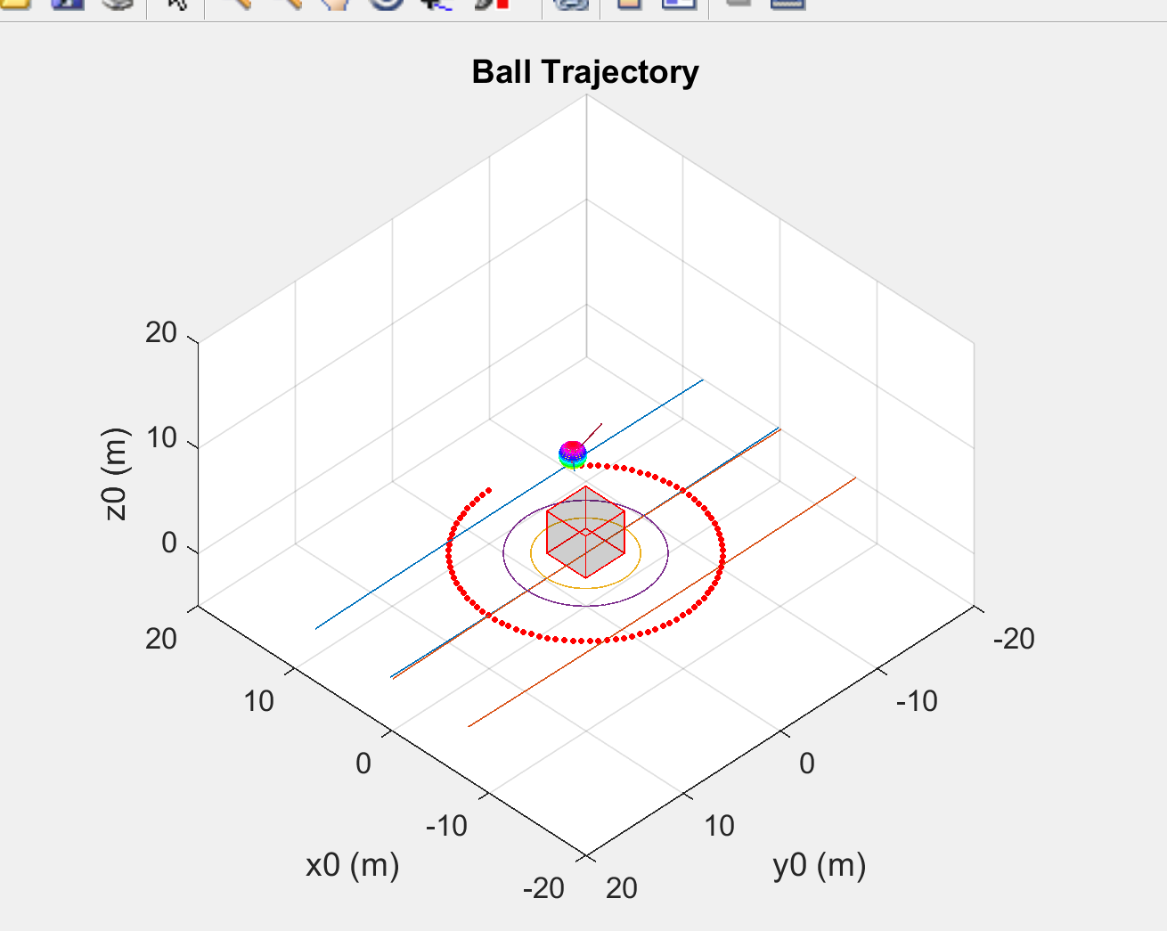
Latest
Ideas:
Add lines representing magnetic field extending from Omnimagnet
Mesh Ball with singular Color
Representing min and maximum of workspace
Only represent magnetic field orientation with z y –axis

